Slide 1
How to Get There? 怎么去？
Lesson 2: Explore

Slide 2
语法运用 句型3: Subject + 还是 + Action + 吧
Activity 5: Practice Grammar Pattern in Context (3)

Slide 3
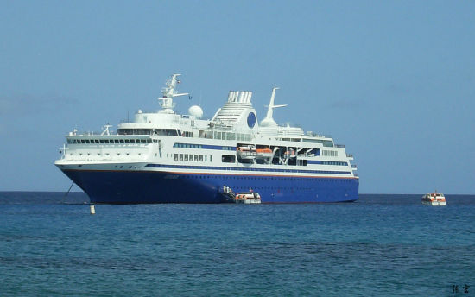
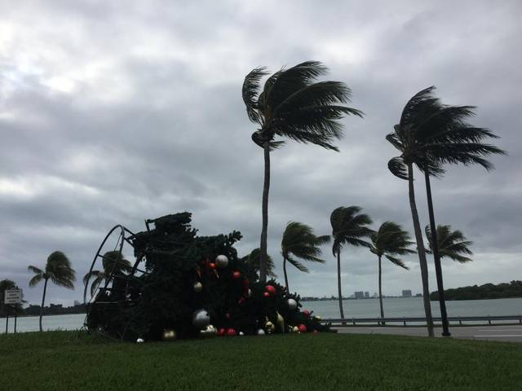
句型3: Subject + 还是 + option + 吧
还是 as an adverb can express "had better" or "it would be better to." The idea is that the speaker has been given several options and has finally come to a decision. The announcement of this decision is expressed by 还是+option, and the use of 吧 to make the suggestion.
坐船fēng大，还是骑马去吧。

Slide 4
Subject + 还是 + option + 吧 "had better" or "it would be better to."
你想吃中国菜，还是意大利菜？为什么？
中国菜：9美元
意大利菜：16美元
http://3.imimg.com/data3/RS/IH/MY-8495731/italian-food-500x500.jpg
https://si.wsj.net/public/resources/images/BN-MK341_NYCHIN_E_20160202154541.jpg

Slide 5
Subject + 还是 + option + 吧 "had better" or "it would be better to."
你想自己做咖啡， 还是去Xīngbākè 买咖啡？ 为什么？

Slide 6
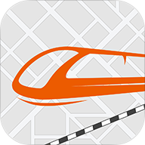
句型2: Place 1 + 离 + Place 2 + 有＃＃里(路) / Adv. + 近 jìn / 远 yuǎn 句型3: Subject + 还是 + option + 吧
你在美国，你怎么去中国？
中国离美国有六千九百二十七英里路, 我们还是坐飞机去吧。
中国离美国很远, 我们还是坐飞机去吧。
6,927 Miles ／ 11,139 km

Slide 7
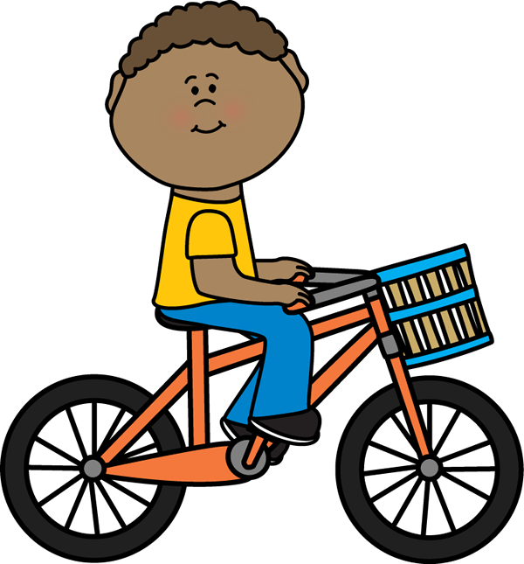
句型2: Place 1 + 离 + Place 2 + 有＃＃里(路) / Adv. + 近 jìn / 远 yuǎn 句型3: Subject + 还是 + option + 吧
你在Worcester, 你怎么去Bōshìdùn?
Worcester离Bōshìdùn有47英里路，我们还是开车去吧。

Slide 8
句型2: Place 1 + 离 + Place 2 + 有＃＃里(路) / Adv. + 近 jìn / 远 yuǎn 句型3: Subject + 还是 + option + 吧
坐飞机？
坐高铁？

Slide 9
句型2: Place 1 + 离 + Place 2 + 有＃＃里(路) / Adv. + 近 jìn / 远 yuǎn 句型3: Subject + 还是 + option + 吧
0.9 Mile
https://s-media-cache-ak0.pinimg.com/736x/52/4b/01/524b01a48c443032a0aaeb277e31281b.jpg
https://s-media-cache-ak0.pinimg.com/736x/58/51/63/58516369ccc6a514ec9441d9b066b75c.jpg

Slide 10
句型2: Place 1 + 离 + Place 2 + 有＃＃里(路) / Adv. + 近 jìn / 远 yuǎn 句型3: Subject + 还是 + option + 吧
0.2 Mile
https://lfcc.edu/wp-content/uploads/2014/08/130121_Student_Union_Header.jpg
https://d1gzo5vknddaf.cloudfront.net/uploads/post/featured_image/88/display_The_Learning_Curve_of_a_College_Classroom.jpg

